Slide 1
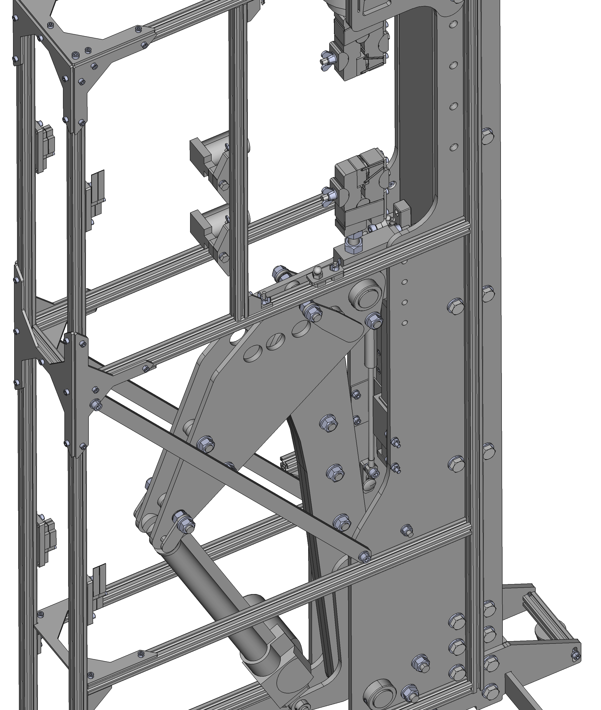
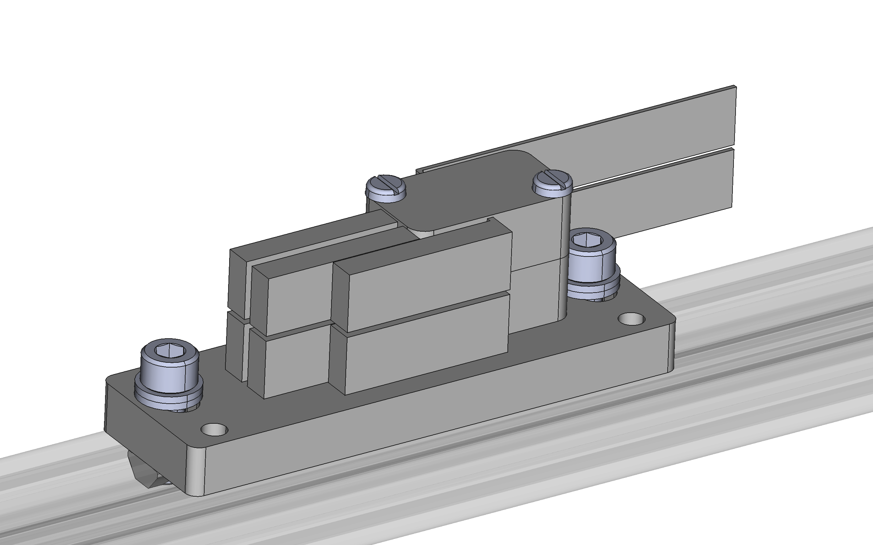

Slide 2
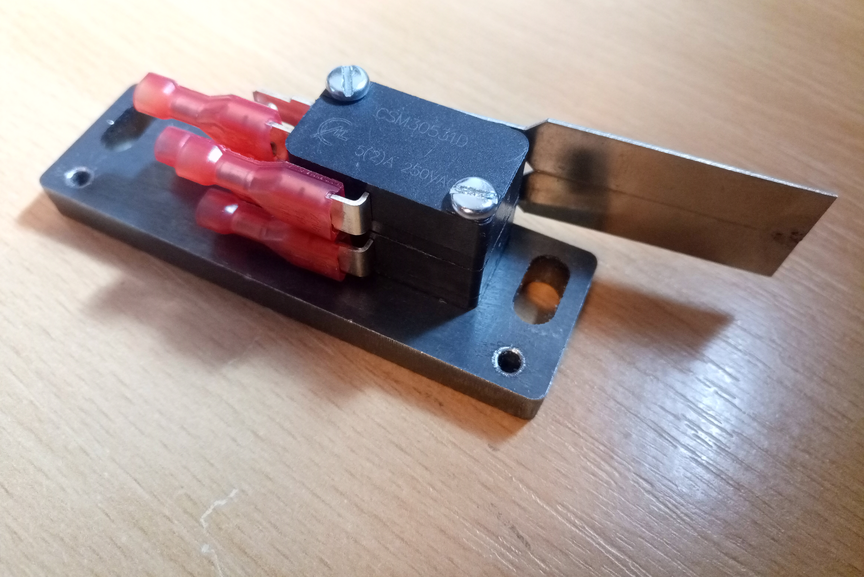
Glue microswitch paddles together
Interlock cables cable tied to side of bracket
File away edge of bracket/microswitch paddle so they clear each other
Microswitches sit in signal/power path, with other two conductors (joined end to end) carrying return signal/power from far end of interlock cable run. Cable screens connected together.

Slide 3
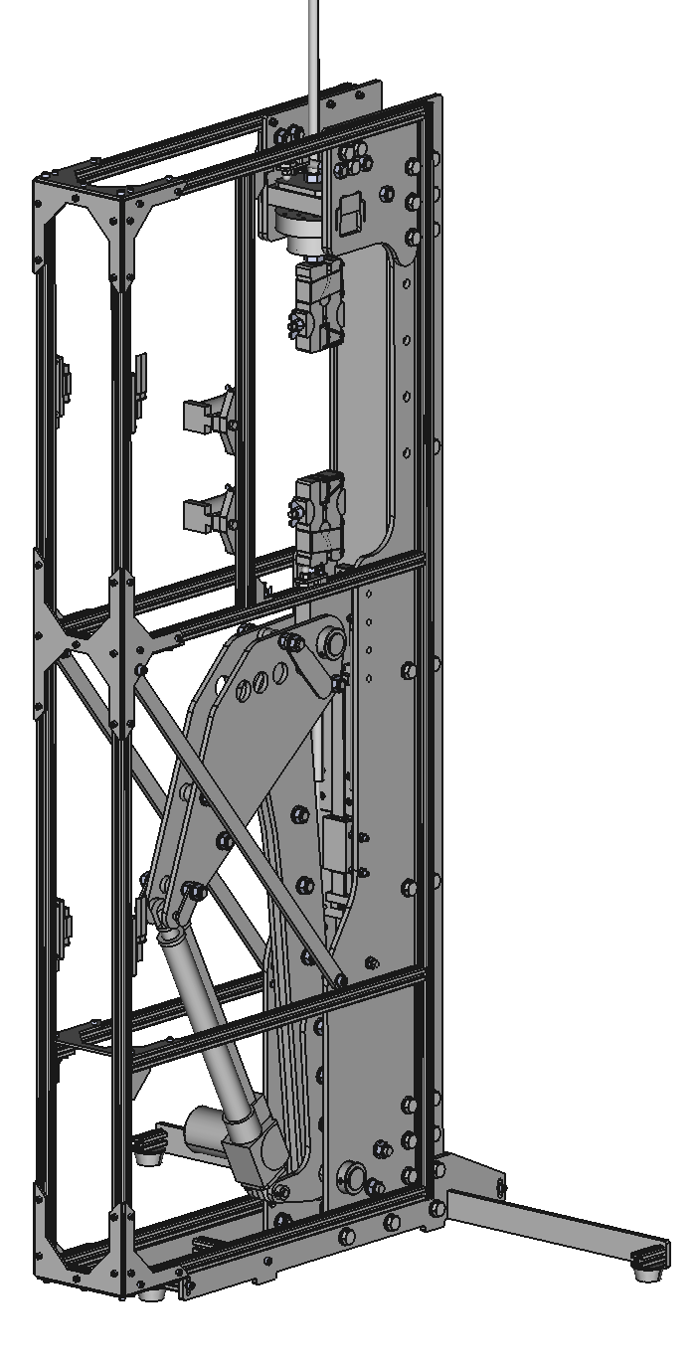
Sample chamber top panel screwed on to rail surfaces (removable)
Sample chamber double-hinged concertina door on both sides of instrument
Sample chamber front panel screwed on to rail surfaces (removable for custom sample optical access)
Cupboard door magnets attached to “upright” aluminium rails, connecting with metal plates attached to the second half of hinged doors
Divider panel slotted in during frame build, with bolted on smaller customisable insert panel. Cut out hole corresponding to cut out in upper rail frame U bracket to run actuator/ interlock cables through
Hinged doors mounted to rearmost aluminium rails
Actuator chamber double-hinged concertina door on both sides of instrument, potentially with key lock to restrict access. One side requires a carefully designed hole for the actuator motor
Actuator chamber front panel slotted in during frame build
Actuator chamber lower panel slotted in during frame build
Doors designed to clear left/right feet

